Slide 1

Personal Loan Campaign

Slide 2

Objective
To predict whether a liability customer will buy a personal loan or not.
Which variables are most significant.
Which segment of customers should be targeted more.

Slide 3
Data Information
The given data contains Axis Insurance company customer’s profile
Variable | Description
ID | Customer ID
Age | Customer’s age in completed years
Experience | #years of professional experience
Income | Annual income of the customer (in thousand dollars)
ZIP Code | Home Address ZIP code.
Family | the Family size of the customer
CCAvg | Avg. spending on credit cards per month (in thousand dollars)
Education | Education Level. 1: Undergrad; 2: Graduate;3: Advanced/Professional
Mortgage | Value of house mortgage if any. (in thousand dollars)
Personal_Loan | Did this customer accept the personal loan offered in the last campaign?
Securities_Account | Does the customer have securities account with the bank?
CD_Account | Does the customer have a certificate of deposit (CD) account with the bank?
Online | Do customers use internet banking facilities?
CreditCard | Does the customer use a credit card issued by Universal Bank?
Observation | Variable
5000 | 14
Notes:
The data set has total 14 columns and 5000 rows
There are missing values in the dataset

Slide 4
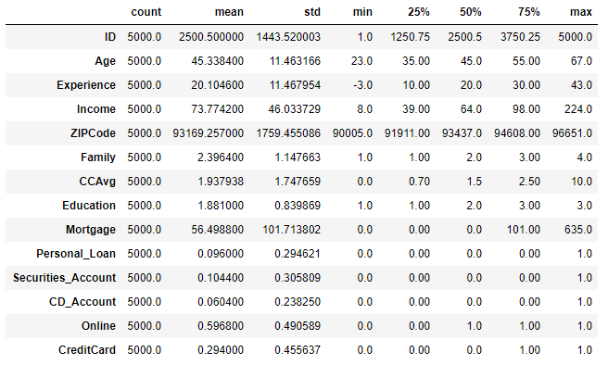
Data Description
Description:
Average age of customer in given data set is 45.34
Average experience of customers in years is 20.10 years. But experience Variable has -ve values which is not correct, this need to be fixed
Average income of customer in dollars is 73.77K
Average family size is 2.4
Average amount spent by customer on credit cart in dollars is 1.93K
On an average most of the customer are Under graduate or graduate
Average house loan customer availed in dollars is 56.5K
For variables: Income, CCAvg, Experience, Mortgage, Security_Account, CD_Accounts, CreditCard has big difference between mean Vs Max values, which suggest that there are some extreme values or possible outliers

Slide 5
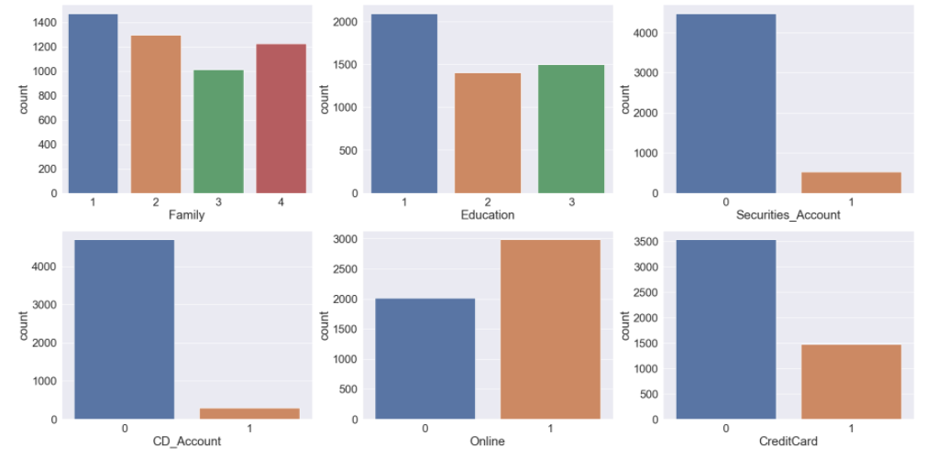
Exploratory Data Analysis – Categorical Variables
Observation
Most of the customer has family size as 1
Most of the customer are Undergraduate
Most of the customer don't have CD_Account, Credit Card and Securities account
Most of the customer use Online banking

Slide 6
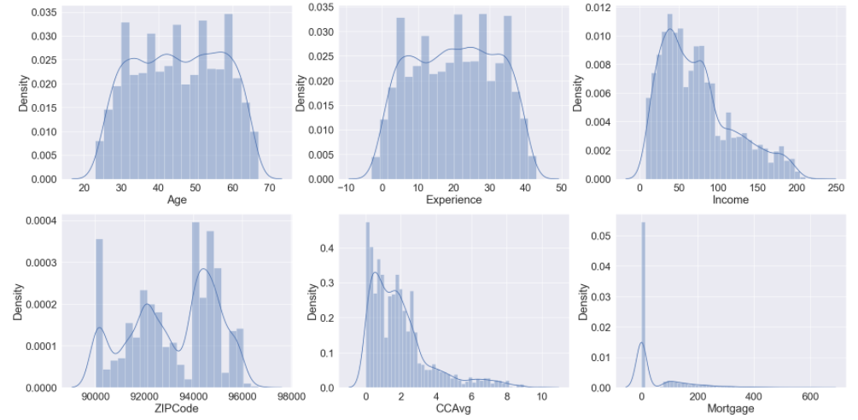
Exploratory Data Analysis – Continuous Variables
Observation
Age and Experience is normally distributed, need to fix experience as it has -ve values which is not correct
Income and CC Avg is right skewed
Most of the customer don't have Mortgage
Zipcode is normally distributed

Slide 7
Exploratory Data Analysis-
Bi-Variate and Multi Variate Analysis

Slide 8
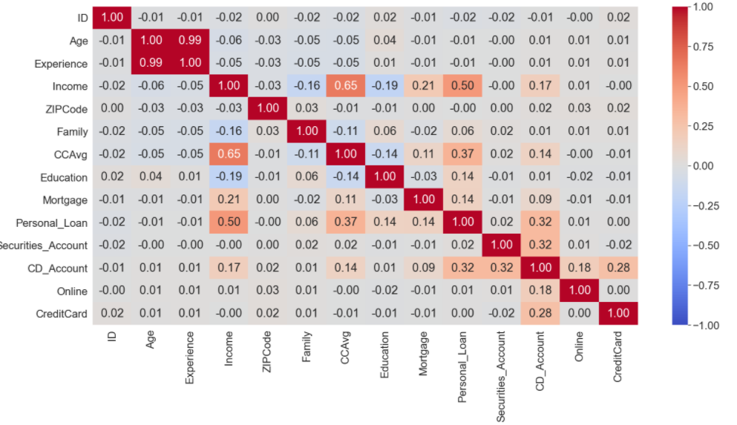
Exploratory Data Analysis- Correlation Matrix
Observation:
Personal Loan has high correlation with Income, Credit card average spending and CD account
In other variable we see high correlation between Age and experience
Income and CCAvg are high correlation with each other
Personal loan doesn't seems to have any major correlation with experience. Since Experience has some -ve enteries,we can look at dropping Experience during data cleaning

Slide 9
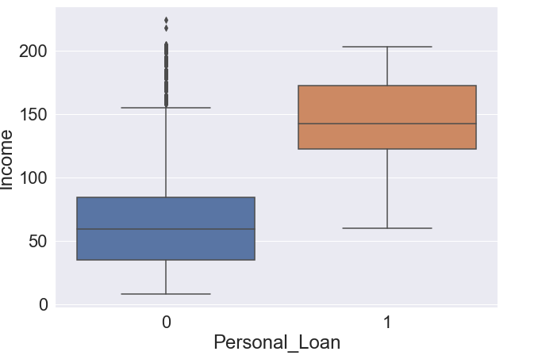
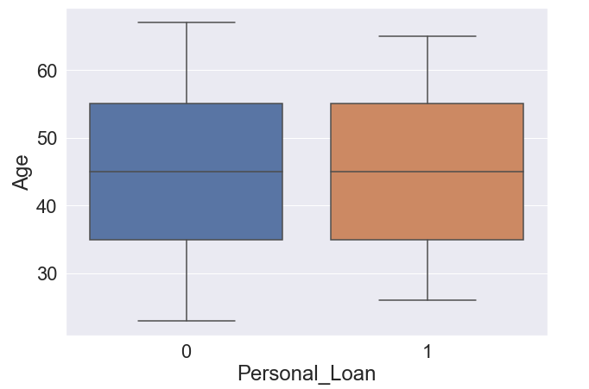
Exploratory Data Analysis- Personal Loan Vs Income and Age
Observation:
Income seems to be one of the major dependent variables, higher the income more chances of customer availing loan
Observation:
Personal Loan doesn't have any major dependency on Age

Slide 10
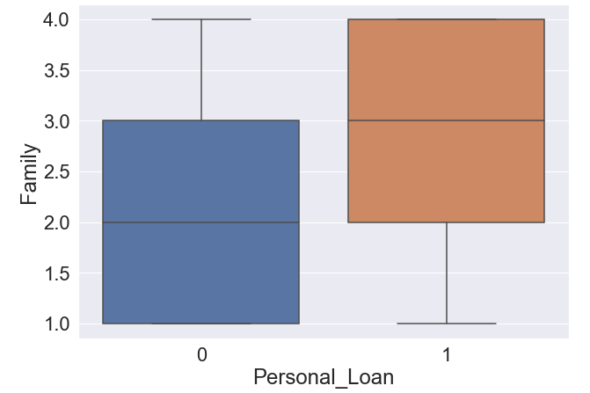
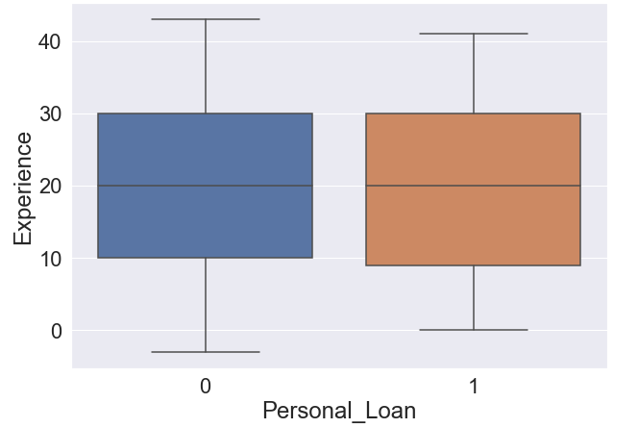
Exploratory Data Analysis- Personal Loan Vs Family & Experience
Observation:
Customers with family size more than or equal to 3 has more chances of having personal loan
Observation:
Personal Loan doesn't have any major dependency on Experience

Slide 11
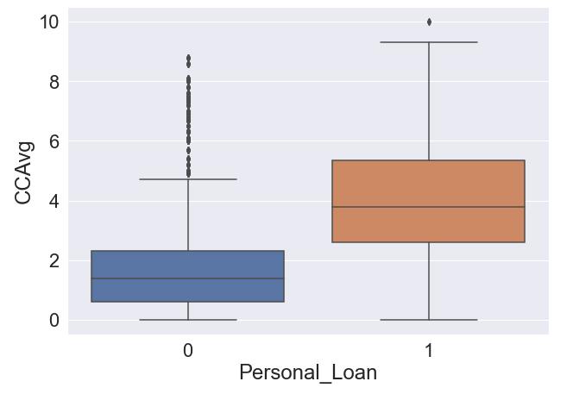
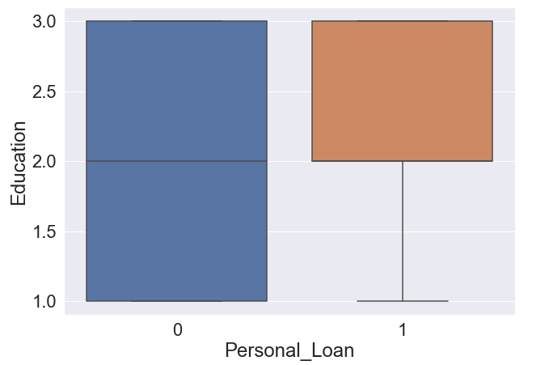
Exploratory Data Analysis- Personal Loan Vs CC Avg & Education
Observation:
Customer who has more spending on Credit cards has more chances to have personal loan
Observation:
Customer with high education level, especially customer who are Graduate or Advanced professional has more chances to avail personal loan

Slide 12
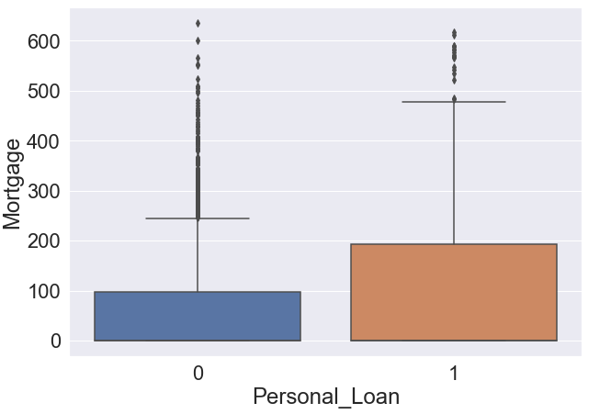
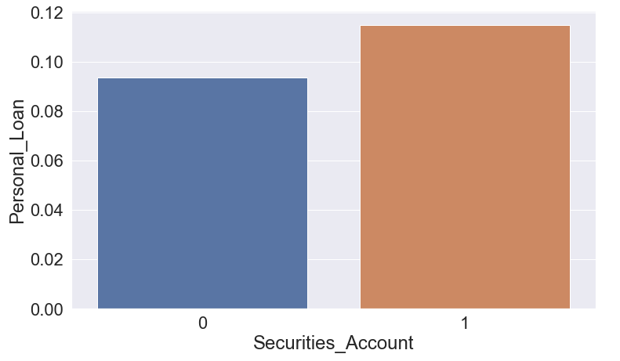
Exploratory Data Analysis- Personal Loan Vs Mortgage & Security Accounts
Observation:
Customer with Securities account has high changes of having personal in comparison to customer with no securities account
Observation:
Customer with Securities account has high changes of having personal in comparison to customer with no securities account

Slide 13
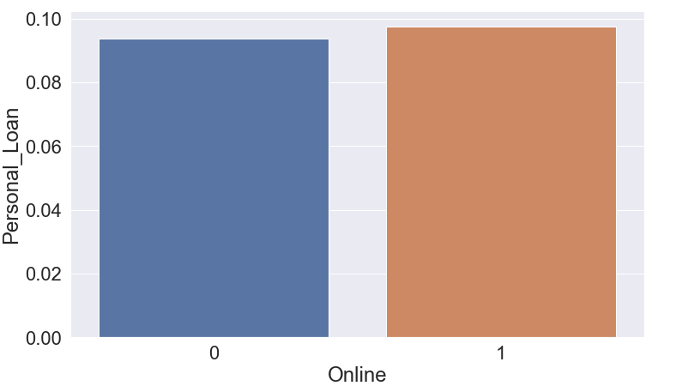
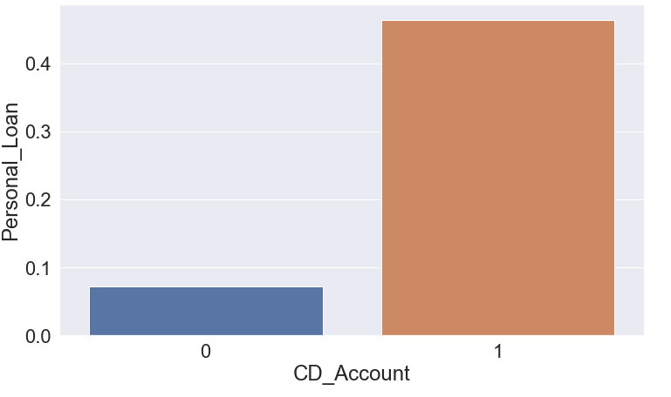
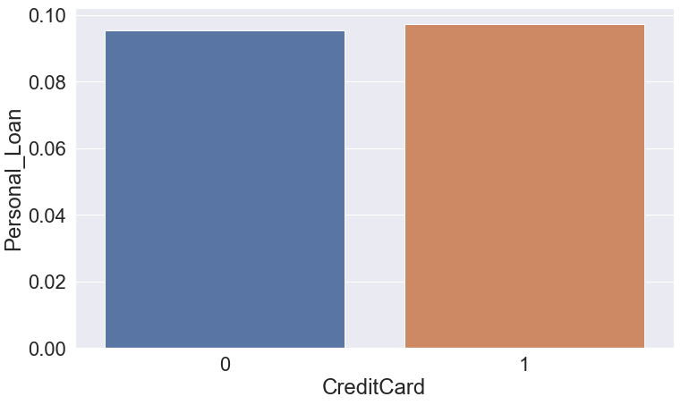
Exploratory Data Analysis- Personal Loan Vs Online Banking, CD Account and Credit Card
Online Banking | CD Account | Credit Card
Observation: Customers using online banking or not doesn't have much impact on chances of customer having personal loan | Observation: Customer with CD account has high changes of having personal in comparison to customer with no securities account | Observation: Customers having Credit card or not doesn't have much impact on chances of customer having personal loan

Slide 14
Logistic Regression- Model

Slide 15
Logistic Regression Model Building
Steps of Modelling
Identify the Dependent Variable: We want to predict Personal Loan, so this will be are dependent/target variable
Data Cleaning, Featuring, Preparation
Split the Data into Train and test
Model Building
Evaluation Model performance using different metrics

Slide 16
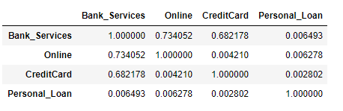
Data Check, Cleaning and Feature Engineering
Data Cleaning:
Duplicates entries where checked in data set and no duplicate rows were found which indicates Data is clean
Variable Experience had –ve Values, since it doesn’t had any significant correlation with Dependent/target variable Personal Loan, it was dropped.
Zip code was dropped as it also doesn’t had any significant impact on target variable
Column ID also doesn’t had any significant impact on Personal loan, it was used as Index for Data Frame
Feature Engineering:
New Feature Bank_Services was used:
Variable Bank_Services was created combining Online and Credit card Variable & check there correlation with Personal loan
New variable have better correlation with personal loan as compared to online and Credit card, so will keep it and drop Online & CreditCard

Slide 17
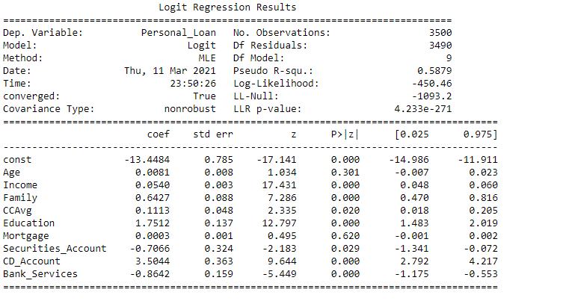
Logistic Regression Model
Observation:
Age, Income, Family, CCAvg, Education, Mortgage, CD_Acount all has positive coefficient, which means that increase in these variables value would increase the chances of customer having personal loan
While Bank_Services and Securities_Account has -ve coefficient

Slide 18
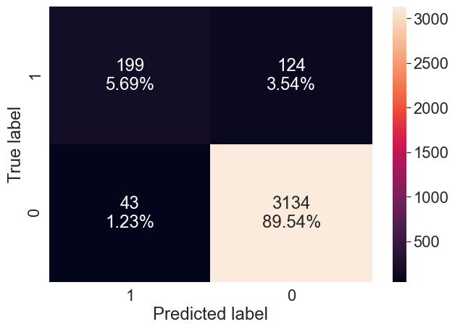
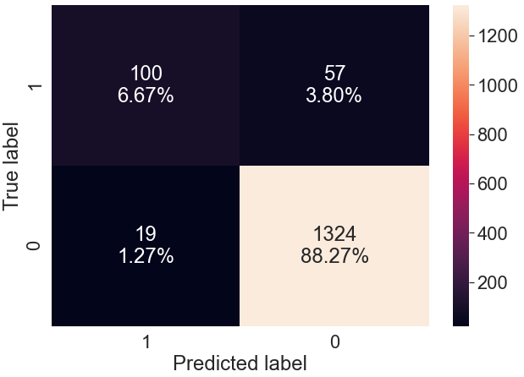
Logistic Regression Model- Confusion Matrix
Prediction on Train Data Set | Prediction on Test Data Set
Accuracy:
Train Data : 95.22%
Test Data : 94.93%
We can see that accuracy on both Train and test is almost same

Slide 19
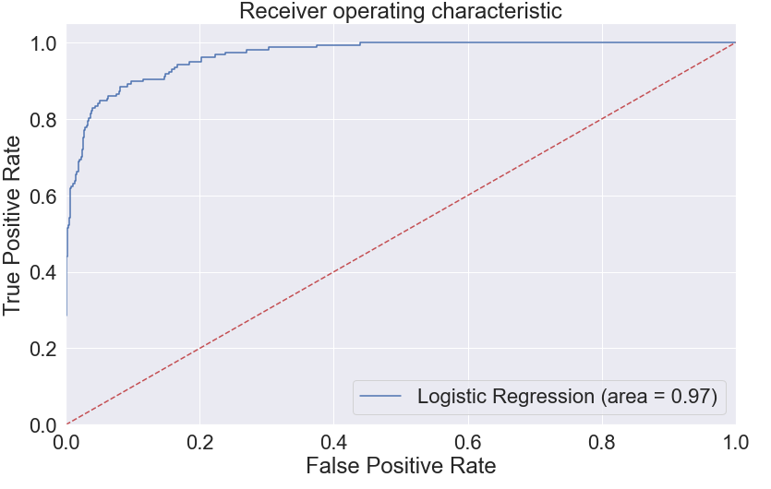
Logistic Regression Model- AUC ROC Curve
From ROC curve we have value of 0.97, which means that our model is good

Slide 20
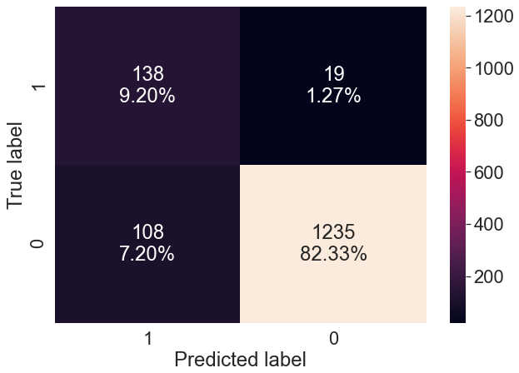
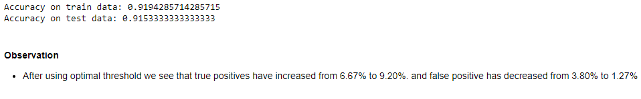
Confusion Matrix- Using Optimal Thresholds

Slide 21
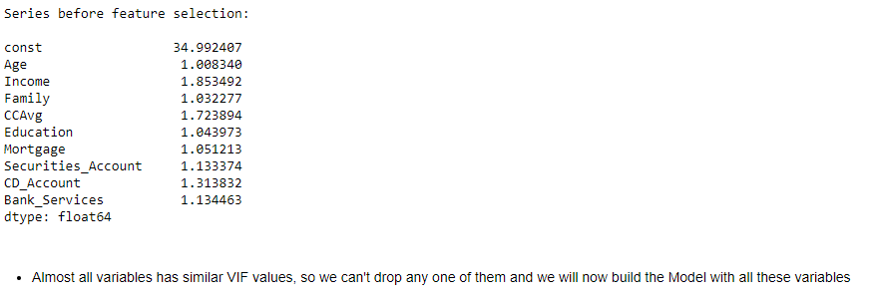
Multicollinearity Check

Slide 22
Decision Tree- Model

Slide 23
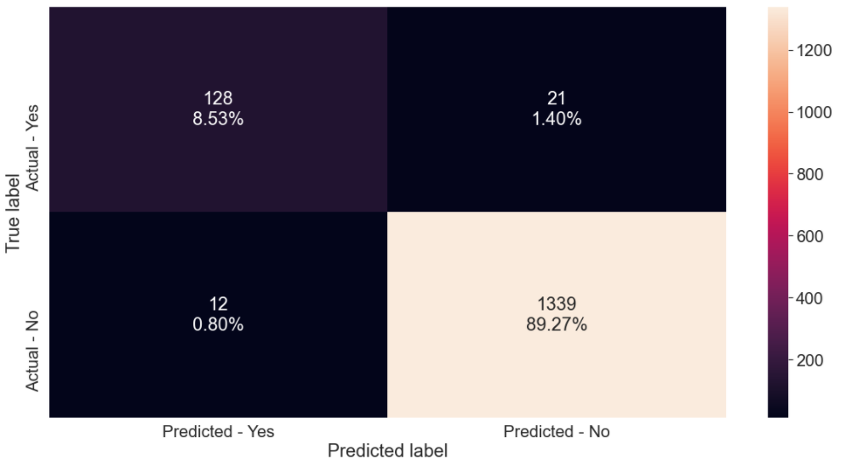
Decision Tree Model- Confusion Matrix
Observation:
As we can see that True positive is only 9%, so if our model marks each sample as negative, still the accuracy of model will be high, which actual is not good metric for Measurement to evaluate the Model
Concern: If the model is not able to correctly identify the potential customers willing to avail Personal loan will be a big loss for the campaign target. Hence, Recall is the right metric to check the performance of the Model

Slide 24
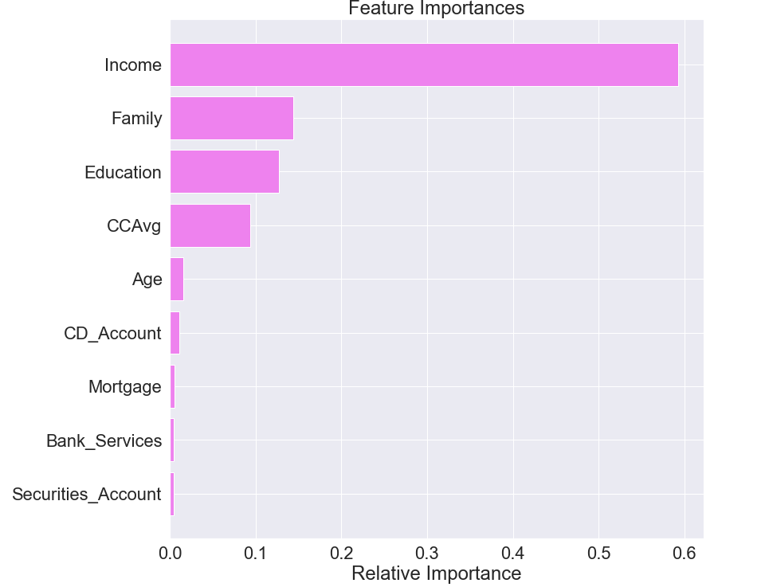
Decision Tree Model- Important Features
Observation:
According to the decision tree model, Income is the most important variable for predicting the Personal Loan

Slide 25
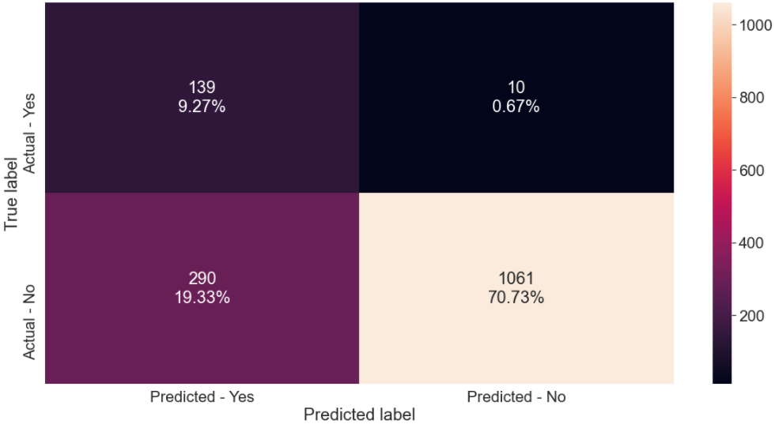
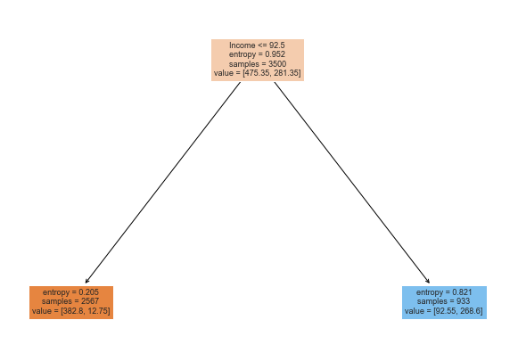
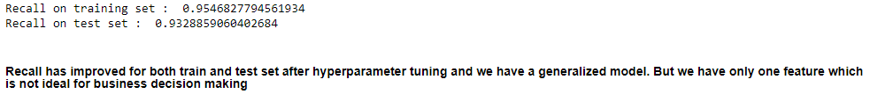
Decision Tree Model- Pre Pruning Using Grid Search

Slide 26
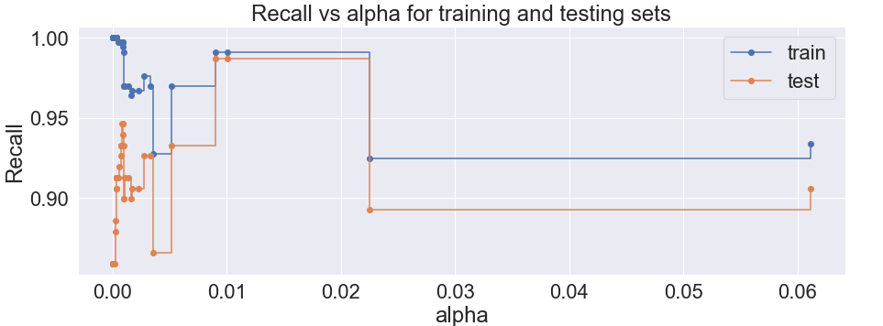
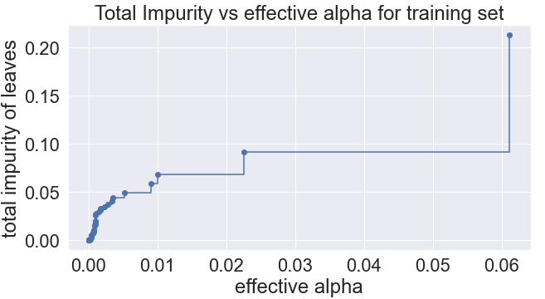
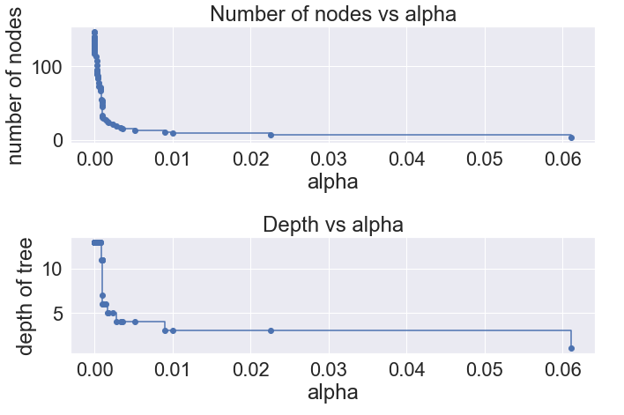

Decision Tree Model- Post Pruning Using Cost Complexity
In Post Pruning:
Major target was to reduce overfitting by using gird search which assist to get the optimal values for Hyper parameters
Using cost complexity pruning method entropy was realized as best criteria to be used
We get best Recall values on train and Test data

Slide 27
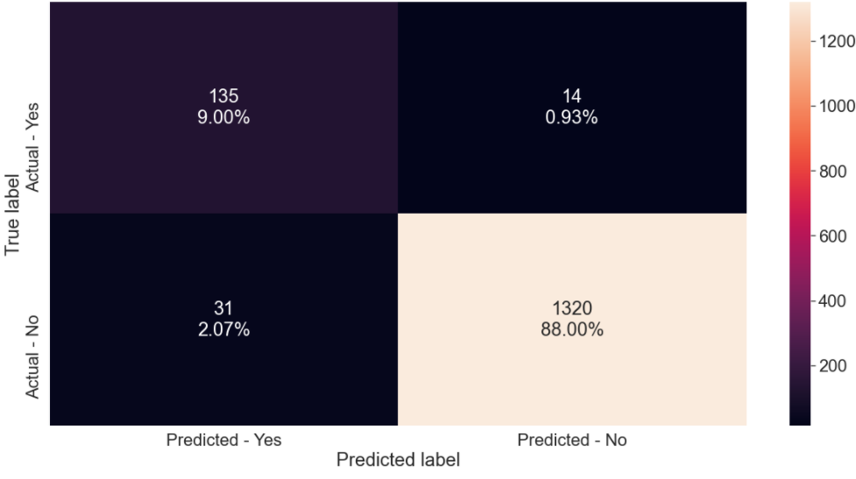
Decision Tree Model- Confusion Matrix Using Different CC Alpha
No further improvement in true positives values was observed

Slide 28
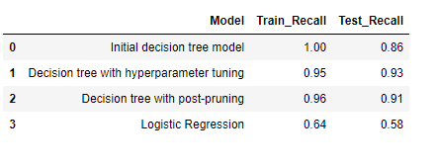
Comparing Models
Conclusion on Models:
We can see the best Recall value for Train and Test Data is for Decision tree with hyper parameter tuning, but in this case we loose all the feature and only income is considered, so this is not an ideal case for Business
Second Best Model is Decision Tree with post pruning, which also maintain the features and has very good Recall values on both Train and Test Data
Best Model for Personal Campaign is Decision tree with post-pruning

Slide 29
Actionable Insights & Recommendations
As we have observed that Income is most important Feature, which indicates that Income has a good effect on Personal Loan, Customers with High Income have more chances of having Personal Loan. So it is advised to Target Customers with high income
CCAvg also show a good relationship with Personal Loan, which means customer who are spending more on credit cards can be targeted for Personal Loan
Since CD account has good relation with Personal loan, customers having CD account can be targeted for personal loans
Customers who has more family members can be targeted for personal loan as well, since the relation between Family variable with personal loan is also good
Customer willing to have high mortgage value can also be targeted for personal loan
Customer whose Education level is high can be targeted for personal loan
Customer using addition bank services like Credit card or online doesn't have any significant impact on personal loan, so marketing/campaign team must not put more focus on such customers

Slide 30
Thank You

